Slide 1
Term 4 Final Presentation Group Number: 7 Group Name: The Legendaries Fake News detection
No. | Surname, Initial | Student Number
1 | Kabai Moipone | 2 | 1 | 5 | 2 | 0 | 3 | 5 | 6 | 9
2 | Mkalali Siphelele | 2 | 2 | 0 | 0 | 4 | 2 | 9 | 2 | 6
3 | Msomi Sebe | 2 | 1 | 6 | 0 | 2 | 8 | 6 | 0 | 4
4 | Ncubukezi Bongeka | 2 | 1 | 5 | 1 | 8 | 0 | 9 | 2 | 5
5 | Tshizana Busiswa | 2 | 0 | 9 | 0 | 5 | 7 | 1 | 8 | 1

Slide 2
Domain area of the Problem
Our domain area of the problem is the spread of Covid-19 fake news, mostly on social media. Social media has allowed people the ability to exchange information at a much greater pace, to a far wider audience than ever before. However, this information is not always truthful.
Since we have found out that more consumption of news was though the corona virus pandemic, the spread of COVID-19 fake news aroused on social media.
In our communities this excessive rise of fake news has had a bad impact where by people were scammed through applications of RDC grant. Their personal information like identity numbers, contacts, addresses were gathered.

Slide 3
Aim and objectives
The main aim of this project is to raise awareness about the impact of fake news across the country.
We proposed to raise this awareness by creating a web application reason being we are a digital generation therefore news travel faster through social media networks.
This application we will not only raise awareness but will also be sharing knowledge and eliminating the knowledge gap within the digital space where news are concerned.

Slide 4
Aim and objectives continues…
The main objective of our research was to implement a solution that will fact-check information before allowing publication, where misinformation will be collected and tracked and denied publications where necessary.
This will help everyone who has once been affected by fake news to know best in future, and also the future generation to be able to identify what’s real, and fake on the media.

Slide 5
Application GUI functionality
For the GUI we used flask, which is a back-end for python.
For the GUI front-end we used HTML, JavaScript, Java, css and Json.
Json is not mainly utilized, we just call some functions from it.

Slide 6
Application design
For our project as a multimedia designer my role was to provide wireframes also known as blue prints as to how the web app would look.
I used the pencil software to execute the activity before handing over to the programmers
The purpose of this was to give an overview of what is expected in the outcomes of the app.

Slide 7
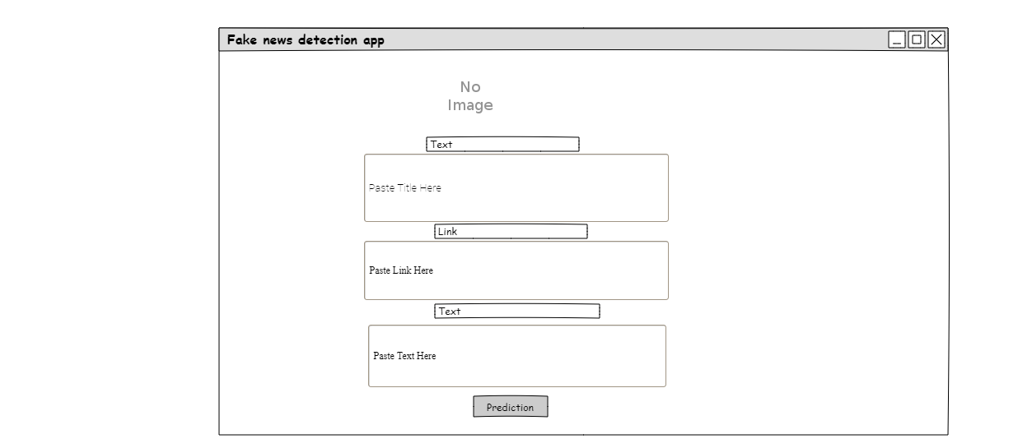
Application design continues…

Slide 8
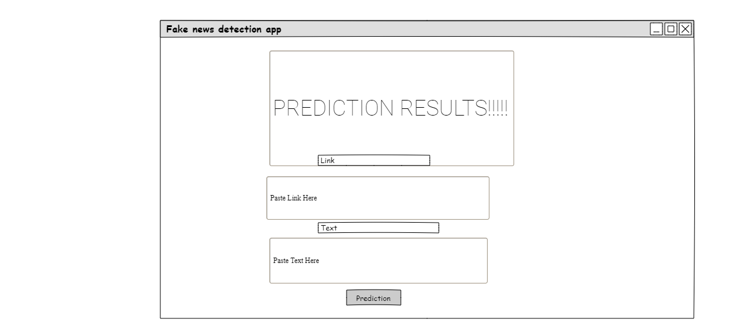
Application design continues…
.

Slide 9
Application functionality
Initially we used the logistic regression algorithm because it was easy to use, but it only returned true results in all inputs whether the fake input was captured.
We changed to passive aggressive classifier algorithm which returned false results whether the correct input was captured.
We used TfidfVectorizer together with passive aggressive classifier algorithms.

Slide 10
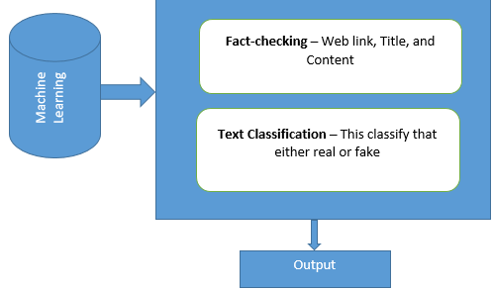
Dataset of the application
Dataset

Slide 11
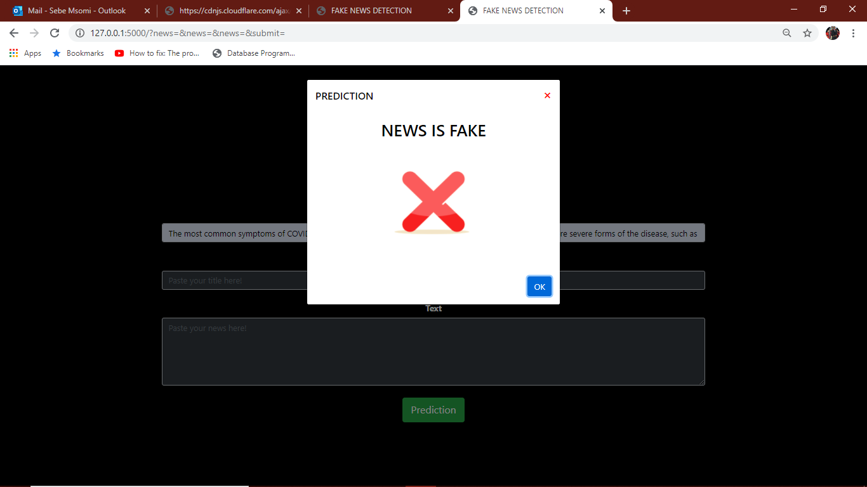
Application functionality continues…
This is the returned output when the Title of the article is captured on its specific field.

Slide 12
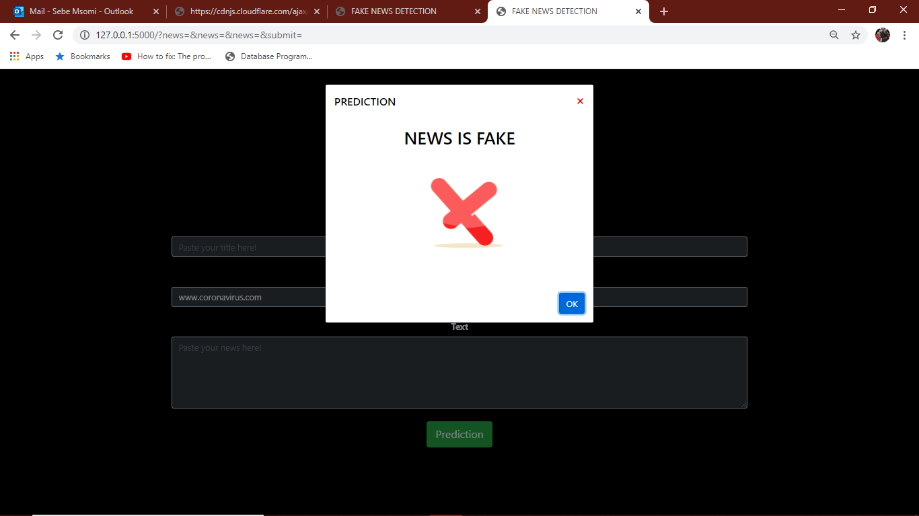
Application functionality continues…
This is the returned output when the link of the news is captured on its specific field.

Slide 13
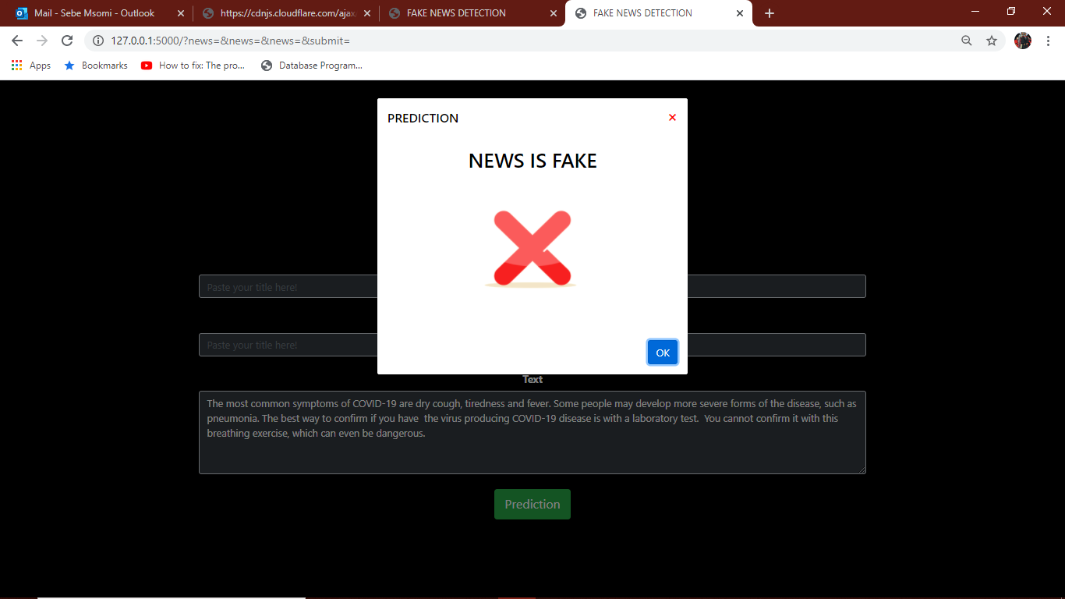
Application functionality continues…
This is the returned output when the content of the news is captured on its specific field.

Slide 14
Constraints of the application
We could not create the register and login page where a user was supposed to start before accessing the login page to access the main fact checking page.
Now we only have the main page where the fake news detection happen.
For someone who would want to create a similar application we would not advice them to use the algorithms we used for this application as they did not bring the required output, which resulted in an application not delivering entirely what was required.
We would advice them to use better algorithms.

Slide 15
Security measures
We have a proxy firewalls, which operate at the application layer to filter incoming traffic between the network and the traffic source.
These firewalls are delivered via a cloud- based solution. Rather than letting traffic connect directly, the proxy firewall first establishes a connection to the source of the traffic and inspect the incoming data packet.
The firewall will least allow incoming traffic on ports 80 and 443 (that is HTTP and HTTPS) and doesn’t know who or what is passing through those ports.

Slide 16
Security measures continues…
We will protect our application by web application firewall (WAF) that specifically analyzes web traffic and blocks any attempt to exploit vulnerabilities such as cross-site scripting or code injection.
A WAF operates like a typical antivirus and antimalware: it looks for known patterns in the data stream and blocks it when it detects a malicious request it protects the organization from botnets, malware, and potential data exfiltrationInput content of the article.

Slide 17
Security measures continues…
We will implement and configure HTTPS and TLS to provide communication security on our web application.
This will verify the authentication on remote server encrypt all the data traversing between users and web application server which will provide Multi factor authentication to verify when there before accessing to prevent attackers that create a fake login page similar to the web application to trick users to log in to steal users’ login credentials.

Slide 18
Security measures continues…
To secure the cookies and session HTTPS will be the best protocol used to secure the data by setting cookie period expiry and removing the session after because the attackers use session hijacking to modify data in transit from the client to the web server.
The implementation of SSL and TLS will help to encrypt the username and password use hashing called Blowfish for the user and for sensitive data and set access control.

Slide 19
The end

